Slide 1
Symbolic Execution
刁说

Slide 2
Agenda：
Software vulnerability detection techniques
Symbolic execution
Tools
Application & my work
Critical problems

Slide 3
Software vulnerability detection techniques
Part 1
Describe software behavior(correctness) → focus on safety
Program analysis
Assessment：
false negative rate(miss) & false positive rate(false alarm)
Classification perspectives:
Textual form ：bit code vs source code
Runtime : static vs dynamic
Methods:
Software Test
Static Program Analysis & Abstract Interpret
Transform Program Behaviors into Logical Formulas (Symbolic Execution)

Slide 4
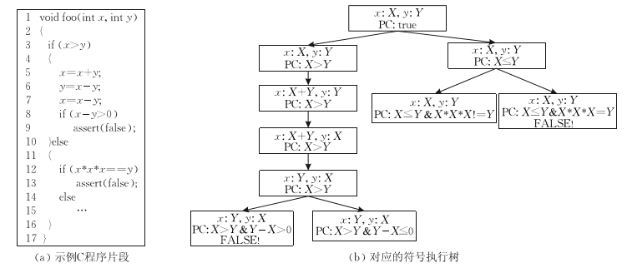
Symbolic Execution
Part 2
Static Symbolic Execution
Main Concepts
Execution path
Path Condition
Execution Tree
Logical Expression
Assignment statement → node with 1 child
Condition statement → node with 1 or 2 child(ren)
Terminal statement → leaf

Slide 5
Symbolic Execution
Part 2
Procedure
Symbolic variable
Symbolic Expression
Path Condition
First-order predicate logic formula

Slide 6
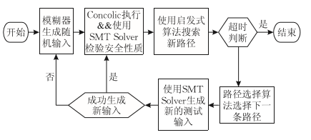
Symbolic Execution
Part 2
Dynamic (concolic)
Concrete Execution
SMT solver(Satisfiability Modulo Theory)
Z3
STP
Heuristic Path Search Algorithm

Slide 7
Symbolic Execution Tools
Part 3
DART
CUTE
KLEE (EXE)
SAGE

Slide 8
Applications
Part 4
Sophisticated tools
PEX(visual studio plugin, unit test)
SLAM → YOGI (model checking)
AGE (automatic vulnerability generation)
S2E (performance analysis)
RevNIC (reverse engineering)
Problems Detected
Windows7
Adobe Acrobat

Slide 9
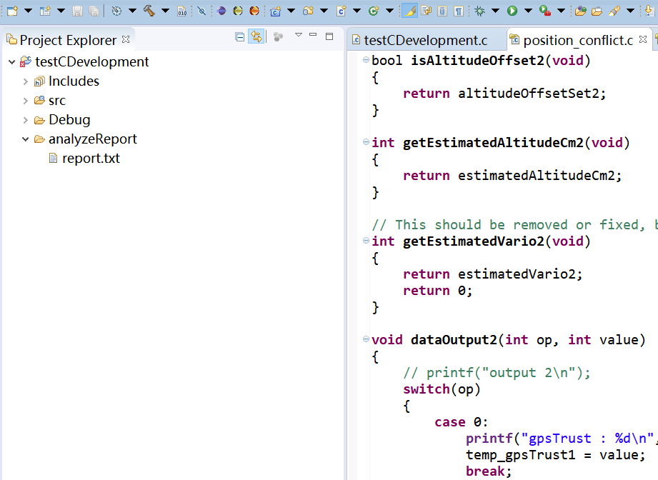
My work
Part 4
PDE
CDT
KLEE

Slide 10
Critical problems
Part 5
Exponential Paths (path explosion)
Availability
Specific Detection

Slide 11
Thanks for Listening.
Q&A

